Slide 1
Improving Evaluation of Autonomous Cybersecurity Agents through Prompt and Execution Trace Analysis - AI Analysis
Muqaddam Aaqil Sheriff

Slide 2
Distinct Types of Tools Used
msf_run
msf_search
nmap
proxychains
shell
ssh

Slide 3
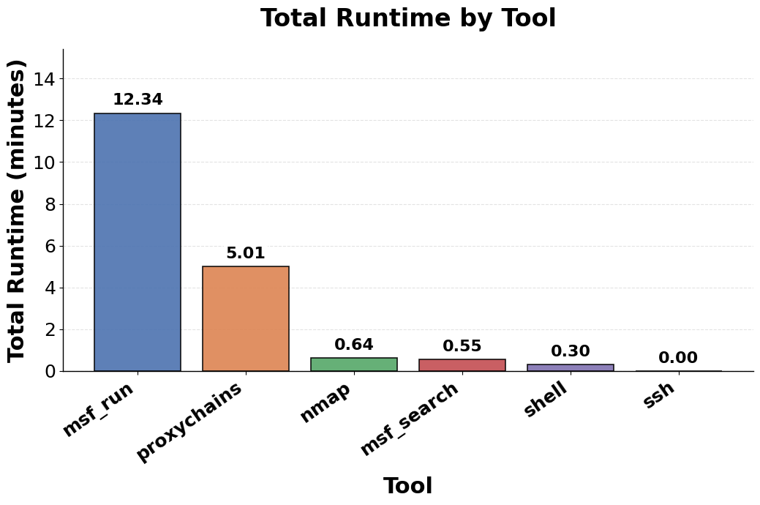
Total Run Time By Tool
Msf_run tool the highest execution time – 12.34 mins
Huge difference between msf_run and the other tools
Last three have similar runtimes

Slide 4
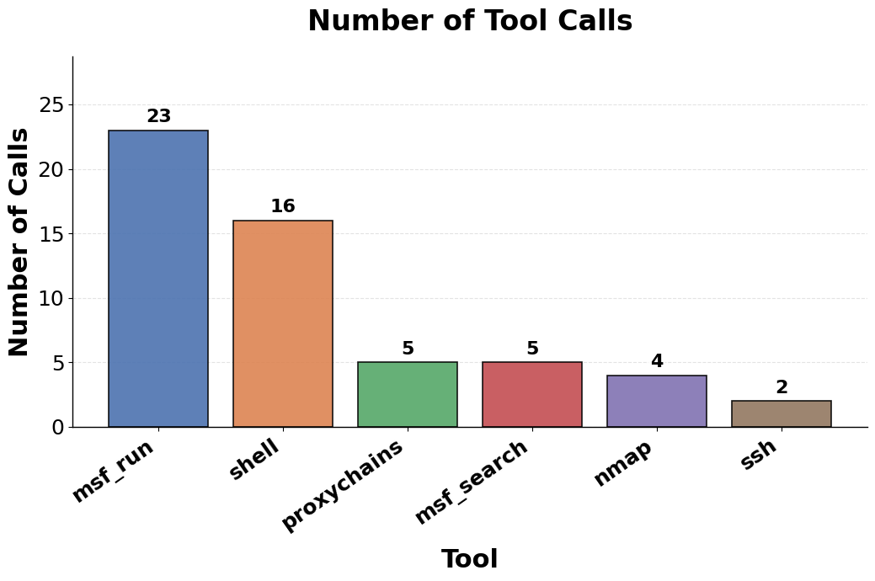
Number of Tool Calls
Msf_run has the highest number of calls
Shell has the second highest number of calls but the total time taken was only 0.30 as compared to msf - (23 calls and 12.34 mins)

Slide 5
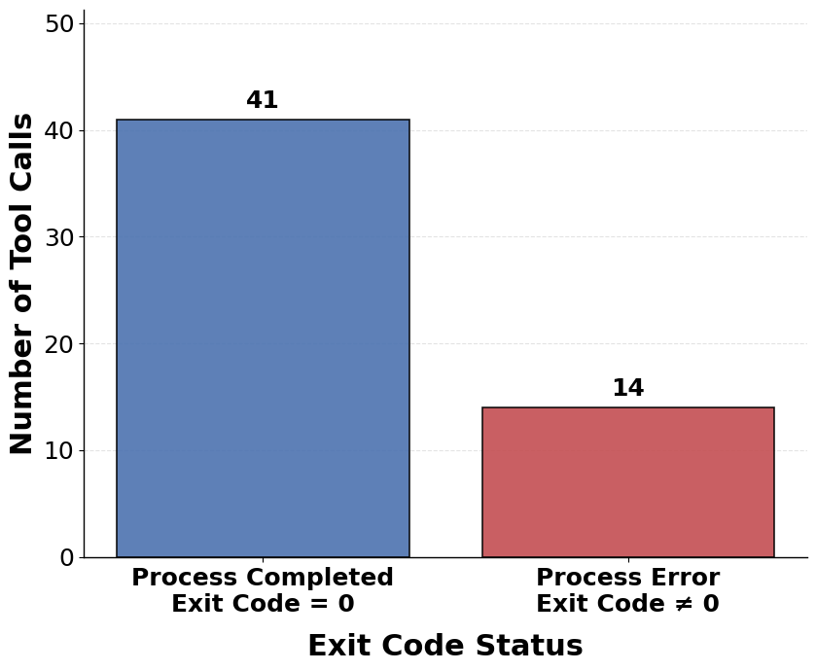
Process Execution Status
Total number of successful processes – 41 (exit code = 0)
Total number of unsuccessful processes – 14 (exit code != 0)
This is according to the AI – Reality shown in next slide

Slide 6
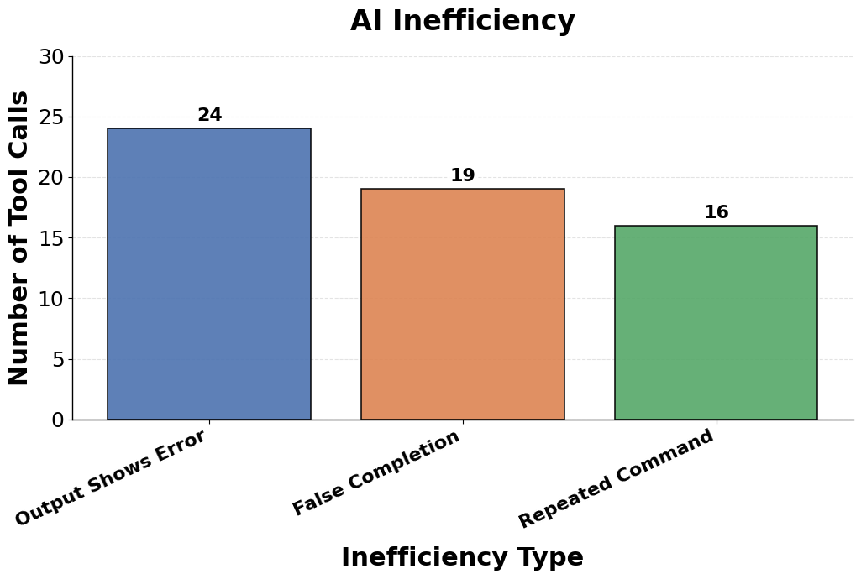
AI Inefficiency
In reality according to the output there were 24 failed processes.
Among the 24, 19 of them had exit code = 0 (successful processes) but still showed error in output.
Commands (args and tools) were repeated 16 times.

Slide 7
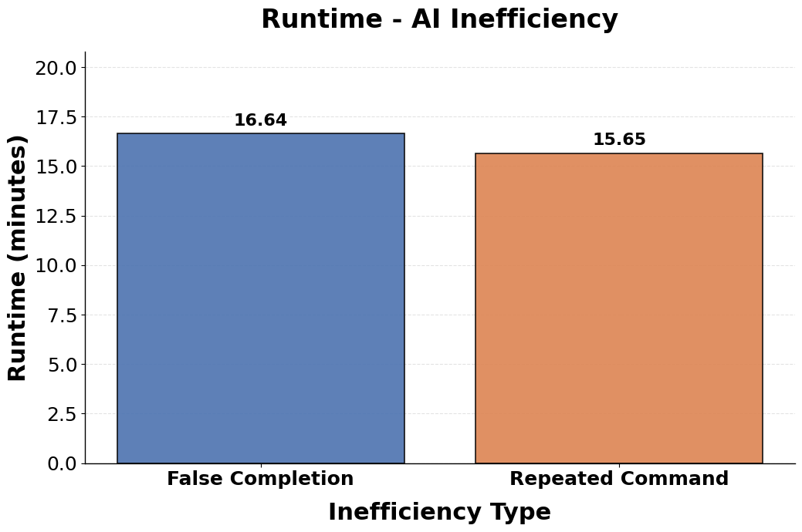
Runtime - Inefficiency
In total it took 16.64 mins was spent on false completion (19 calls in previous slide - 6)
In total it took 15.65 minutes in repeating the commands (args and tools) - (16 calls in previous slide - 6)

Slide 8
Analysis With new datasets
acosta_kali_mcp_run_2026-04-29_12-44-17_native
acosta_kali_mcp_run_2026-04-29_13-22-59_native
acosta_kali_mcp_run_2026-04-29_13-22-59_native-v2
arpspoof-agentflow_run_2026-05-05_00-46-12_native
pivot-web-acosta_kali_mcp_run_2026-04-30_11-04-47_native
rh-agentflow_run_2026-05-02_11-04-13_native
shellshock-agentflow_run_2026-05-03_23-26-45_native
webmin-agentflow_run_2026-05-06_13-20-17_native

Slide 9
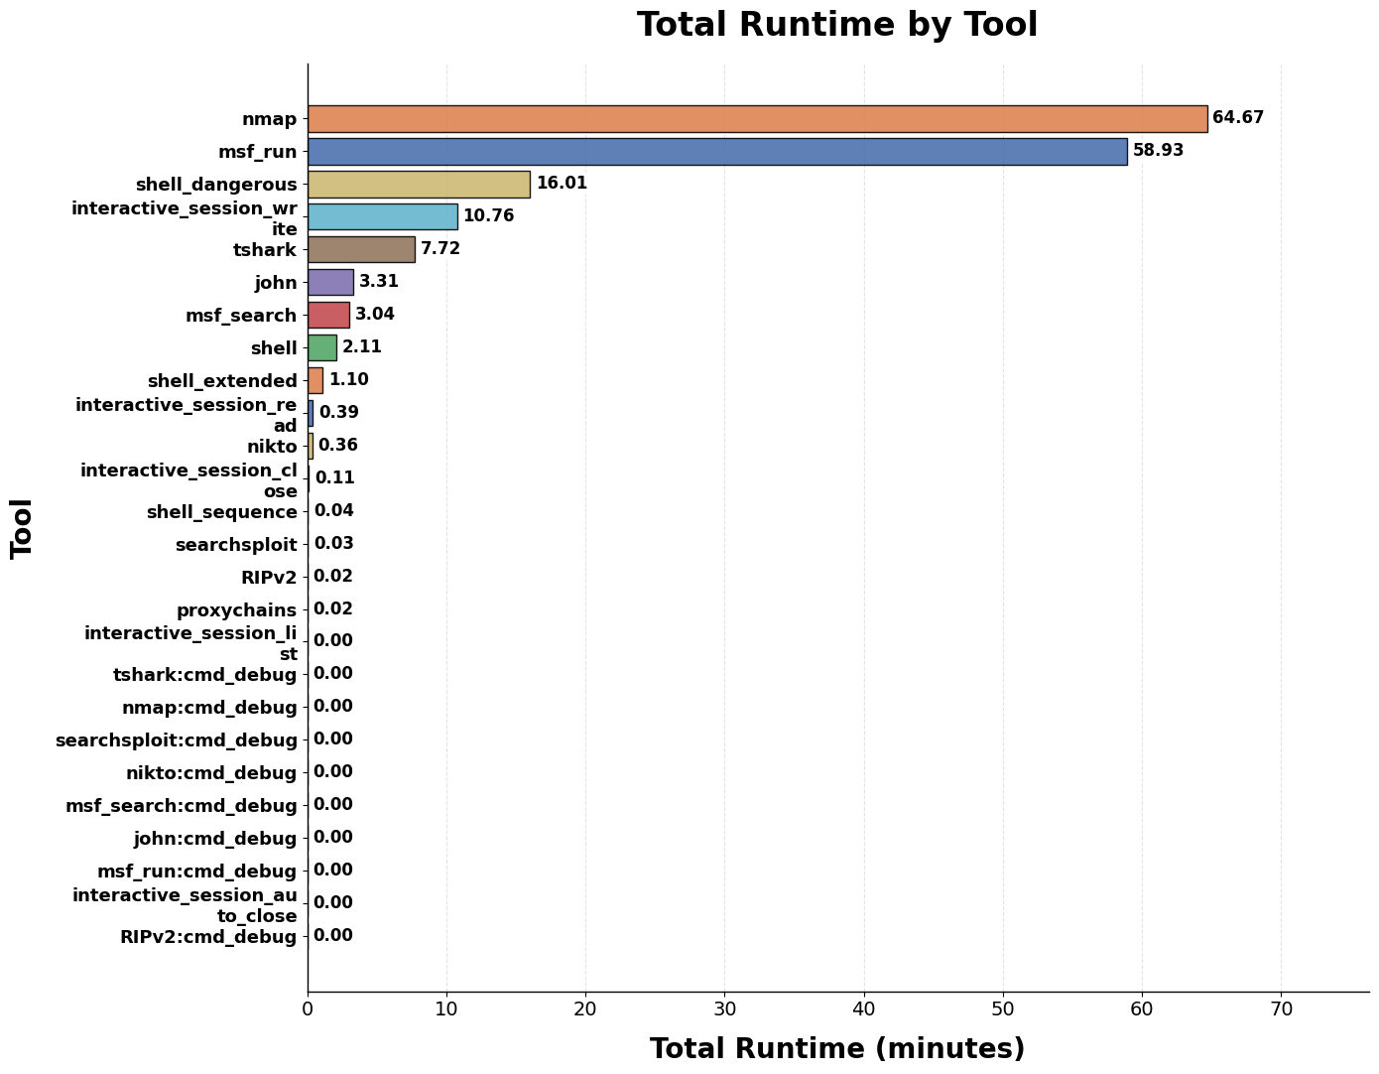
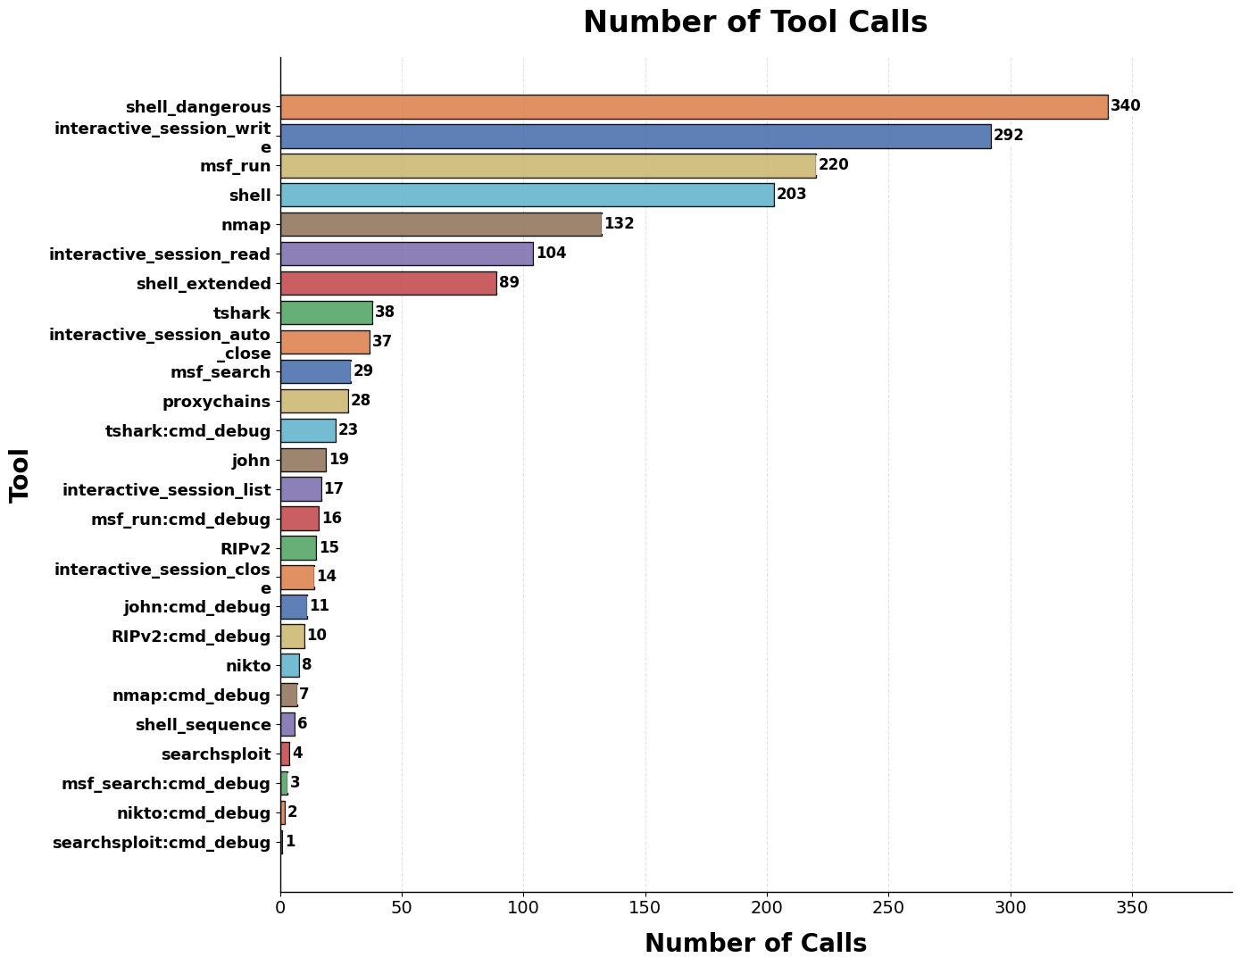
All Tasks Combined

Slide 10
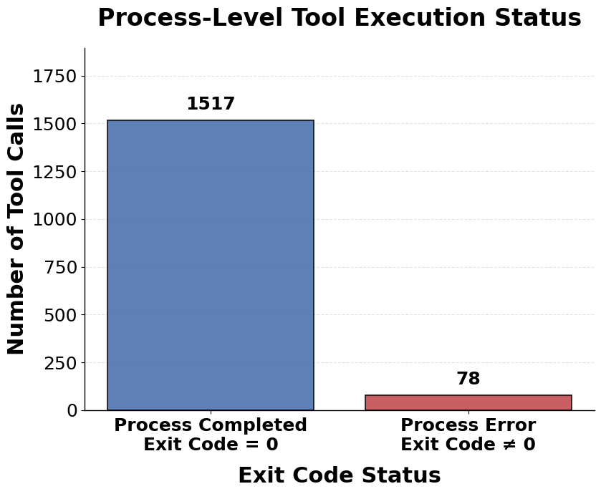
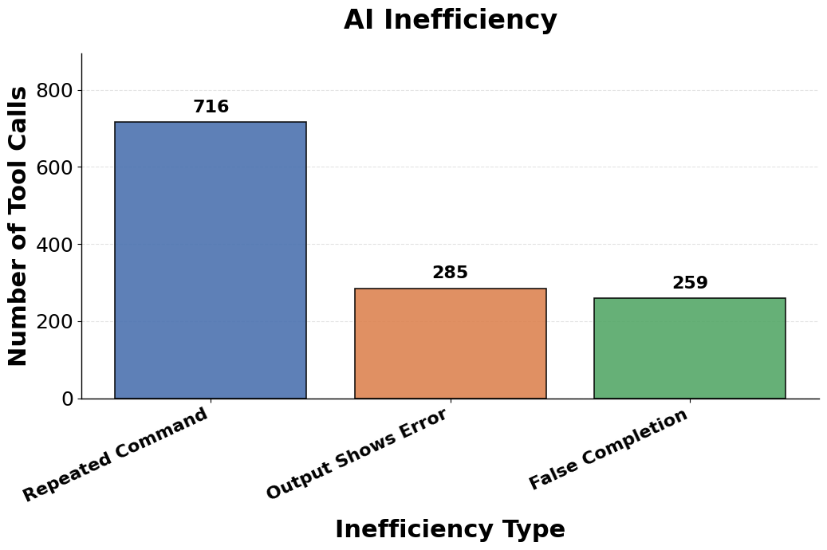
All Tasks Combined

Slide 11
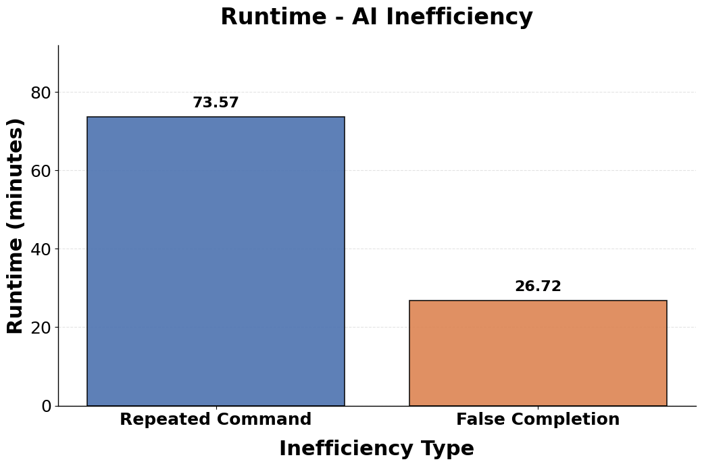
All Tasks Combined

Slide 12
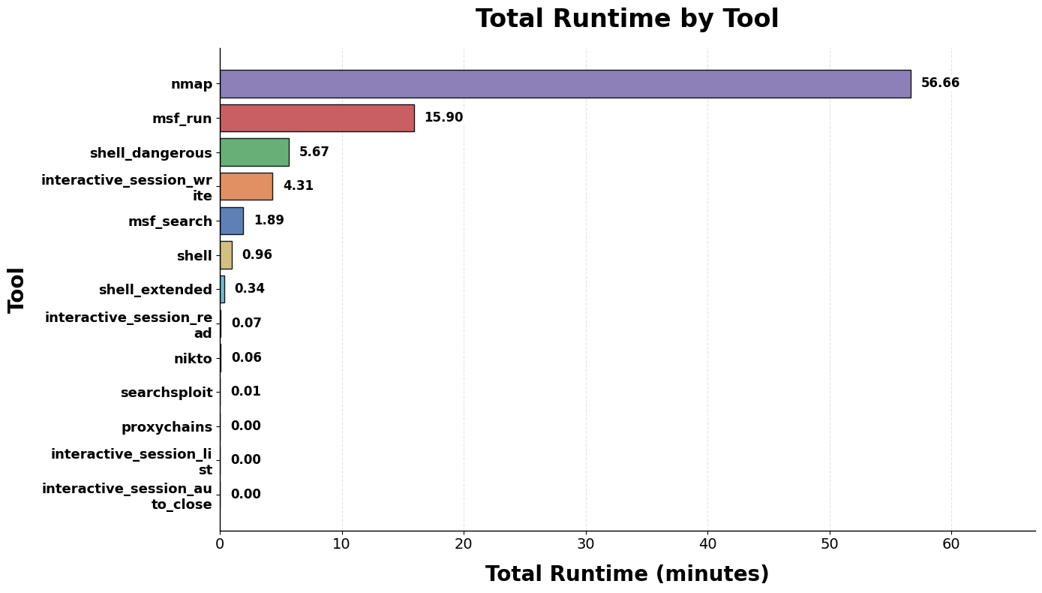
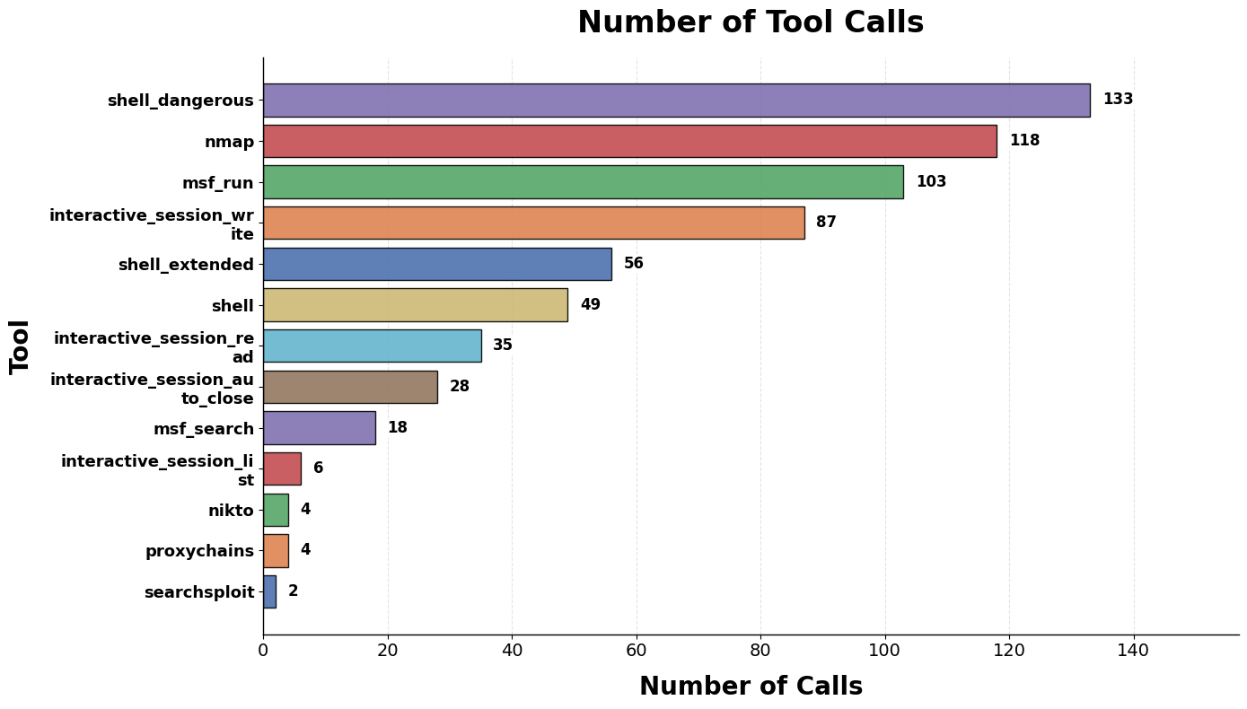
Combination of first three files: acosta_kali_mcp_run

Slide 13
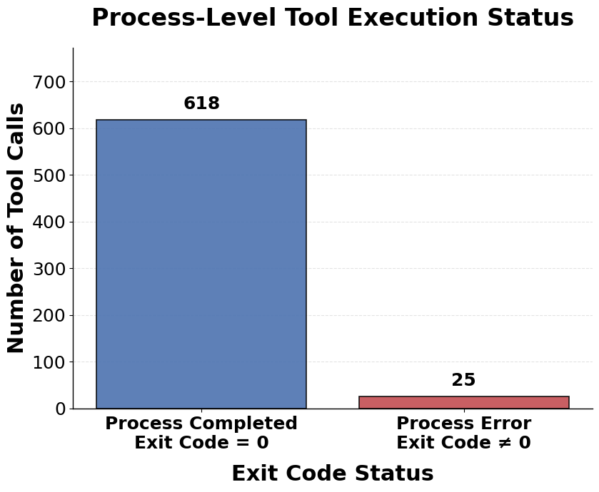

Combination of first three files: acosta_kali_mcp_run

Slide 14
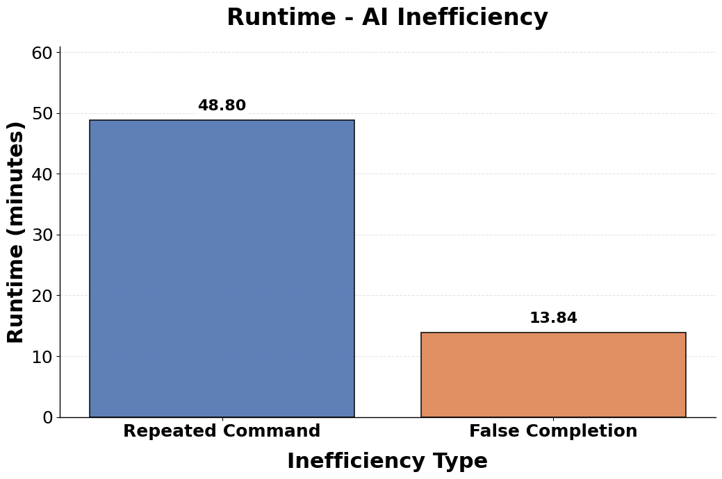
Combination of first three files: acosta_kali_mcp_run

Slide 15
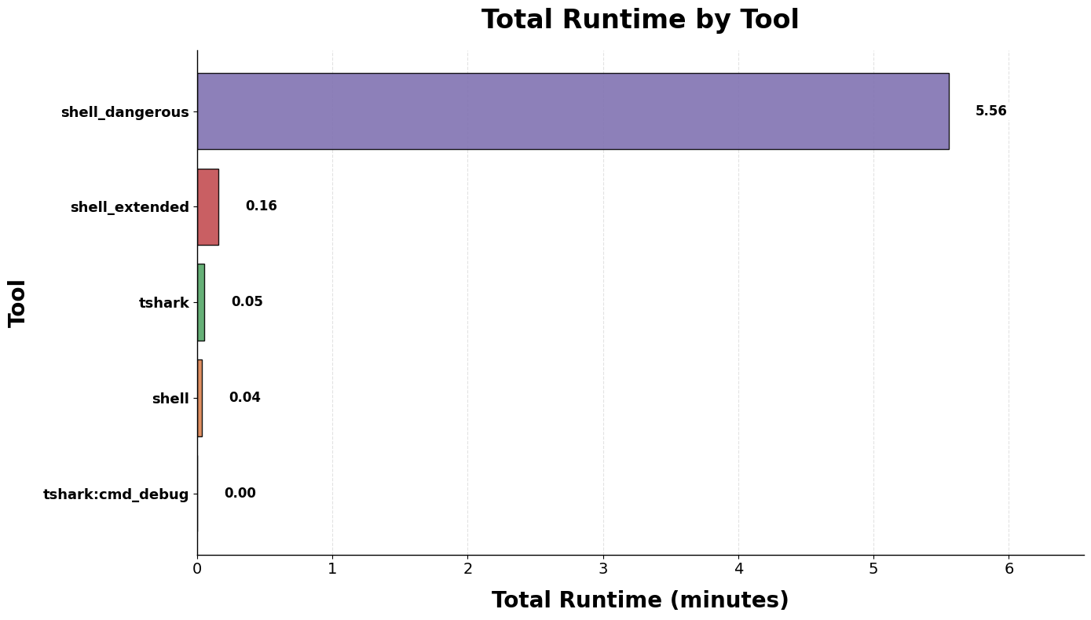
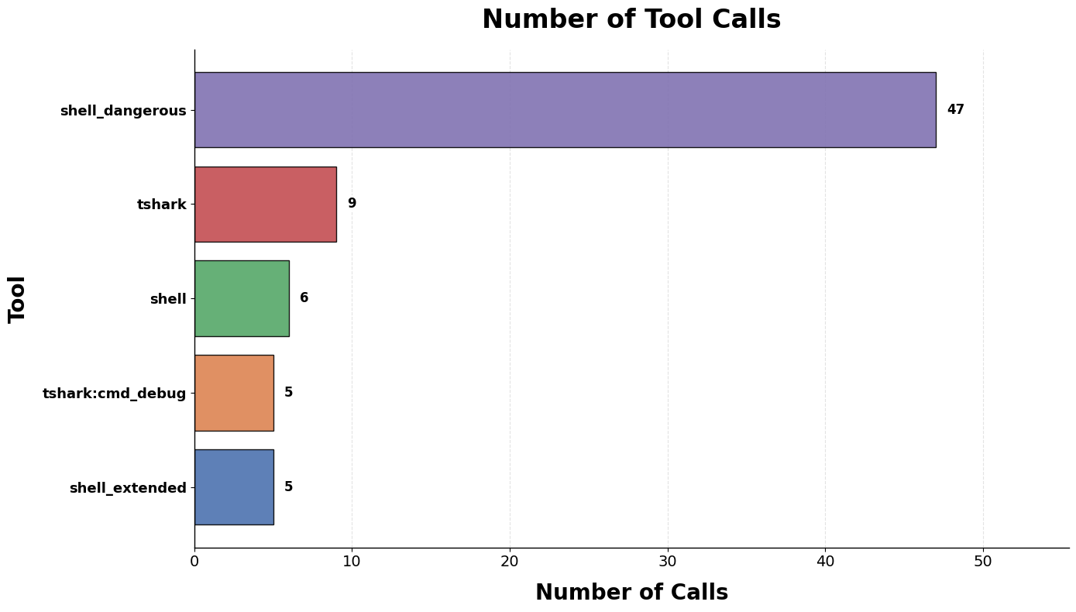
arpspoof-agentflow_run_2026-05-05_00-46-12_native

Slide 16
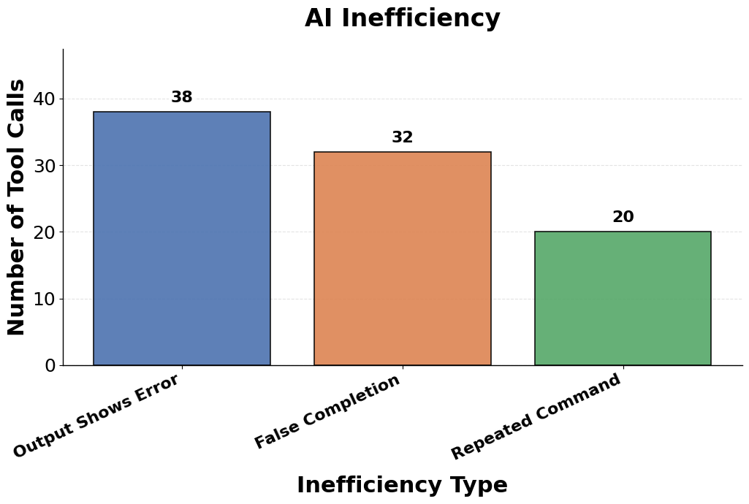
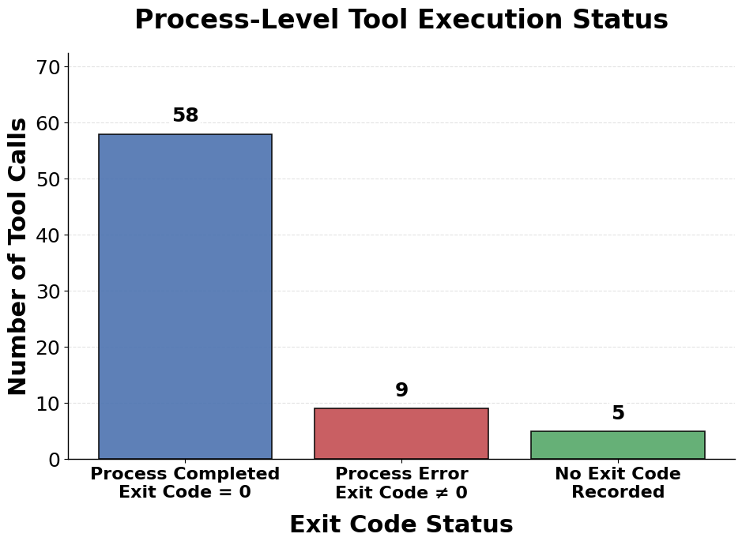
arpspoof-agentflow_run_2026-05-05_00-46-12_native

Slide 17
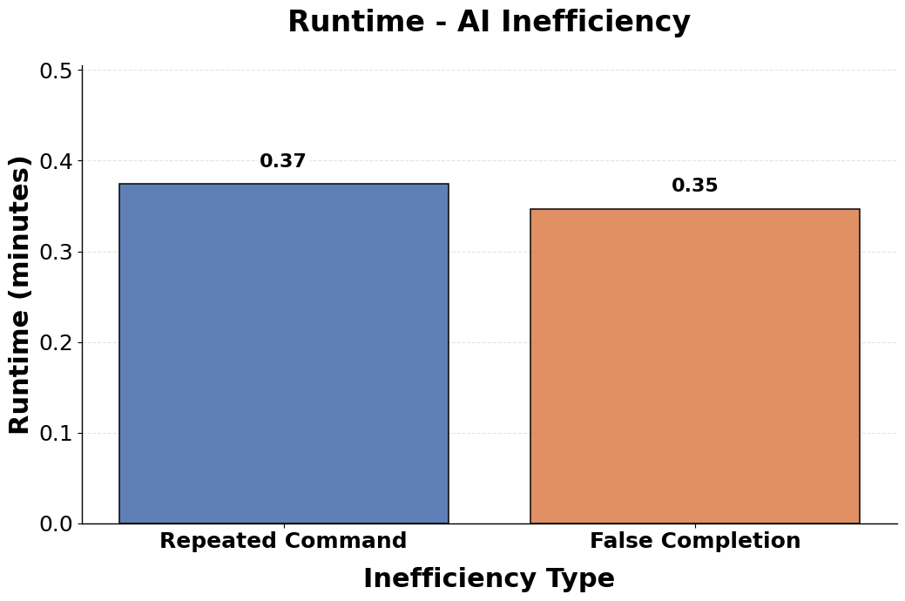
arpspoof-agentflow_run_2026-05-05_00-46-12_native

Slide 18
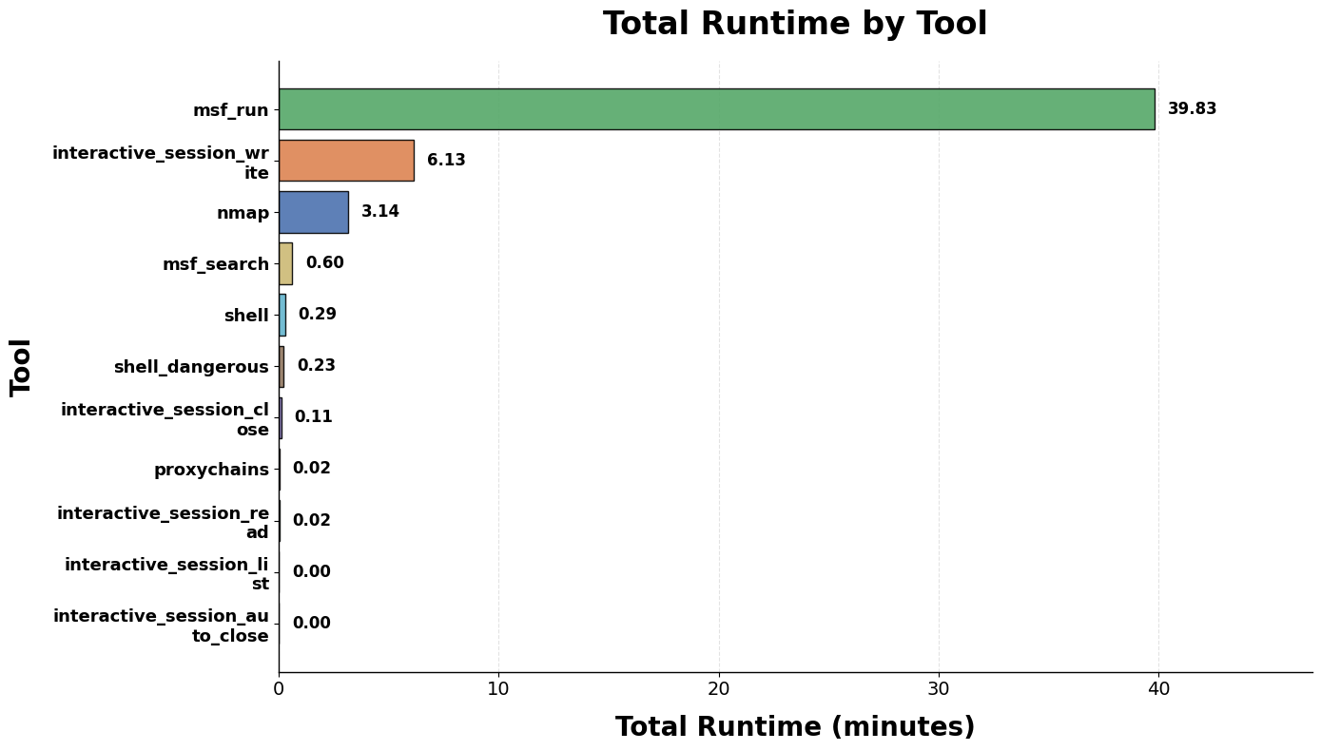
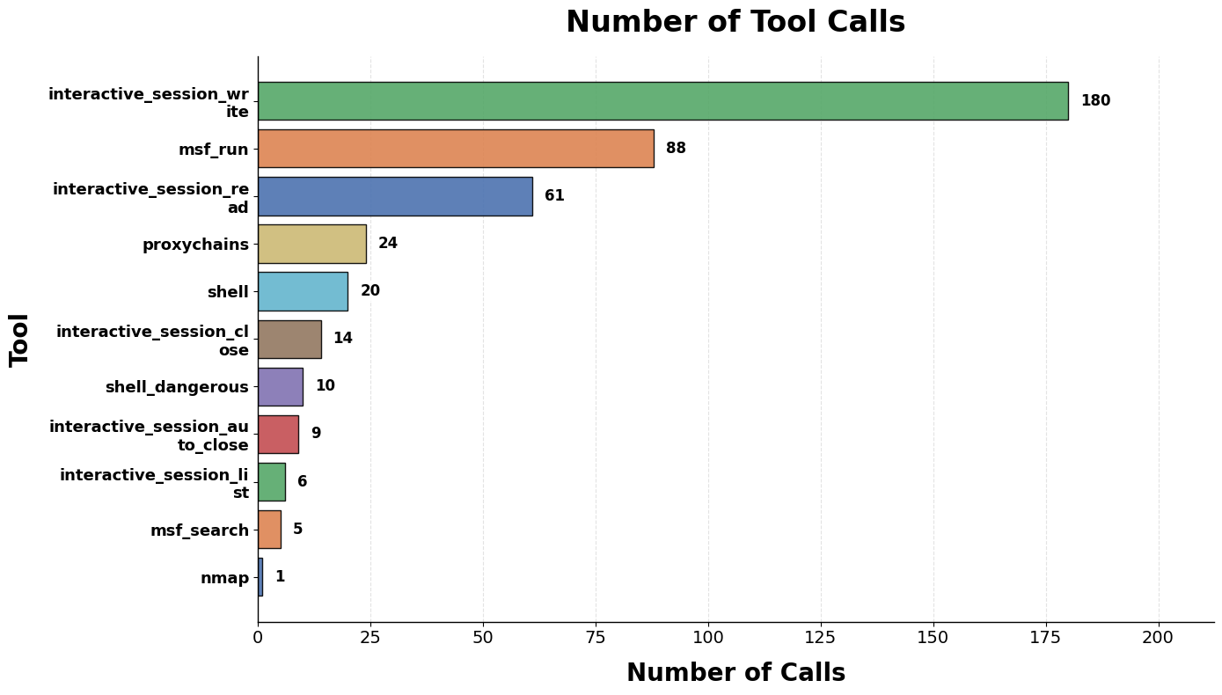
pivot-web-acosta_kali_mcp_run_2026-04-30_11-04-47_native

Slide 19
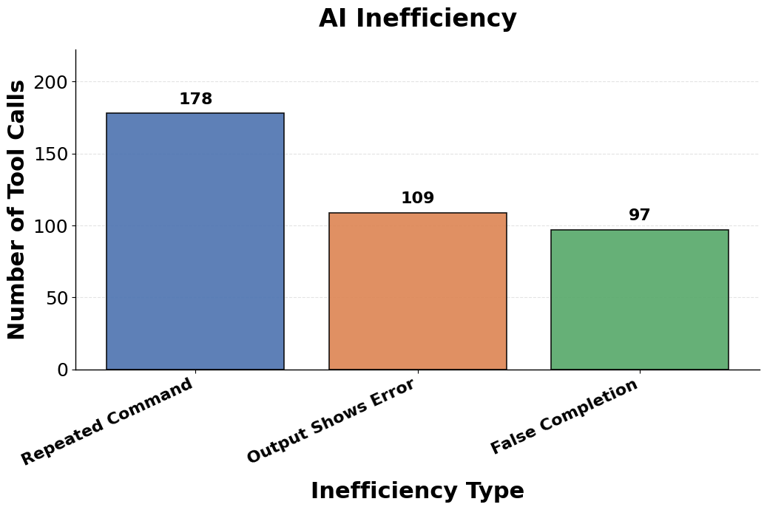
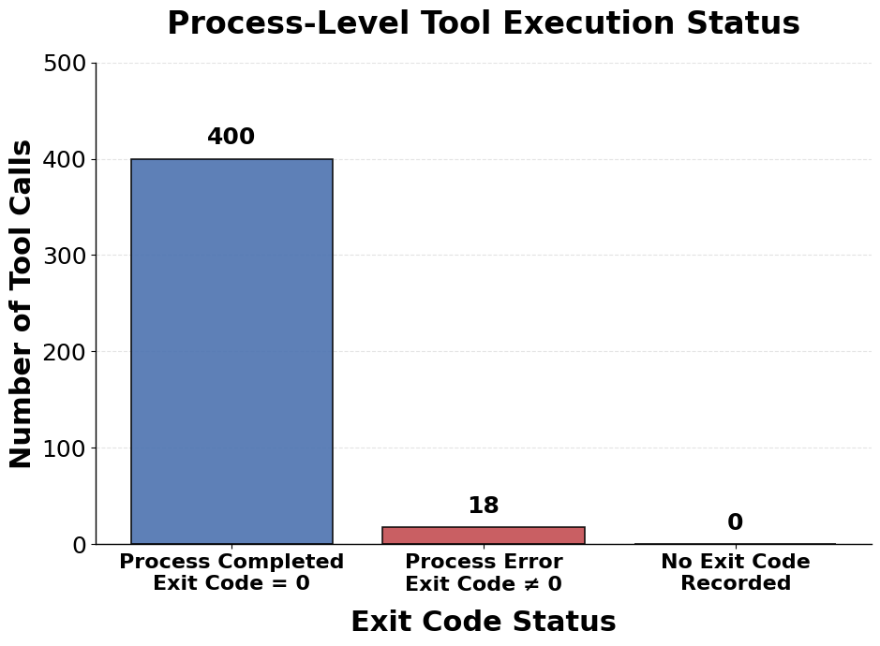
pivot-web-acosta_kali_mcp_run_2026-04-30_11-04-47_native

Slide 20
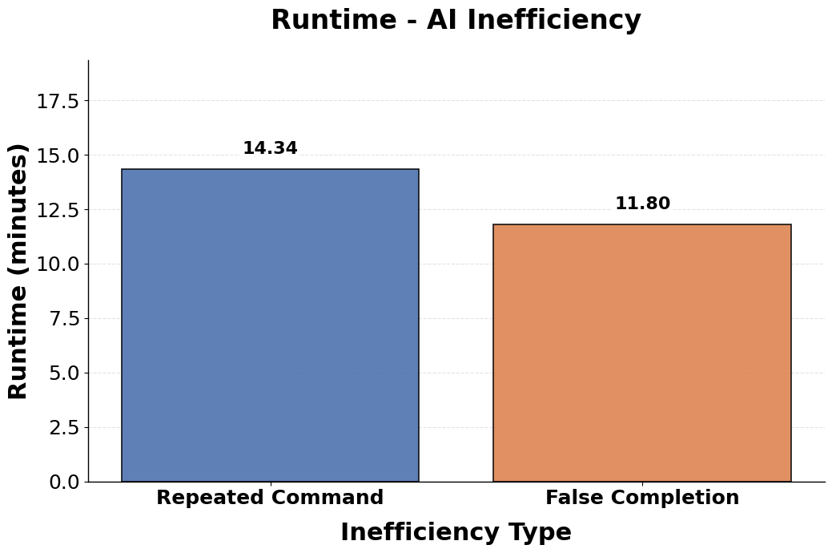
pivot-web-acosta_kali_mcp_run_2026-04-30_11-04-47_native

Slide 21
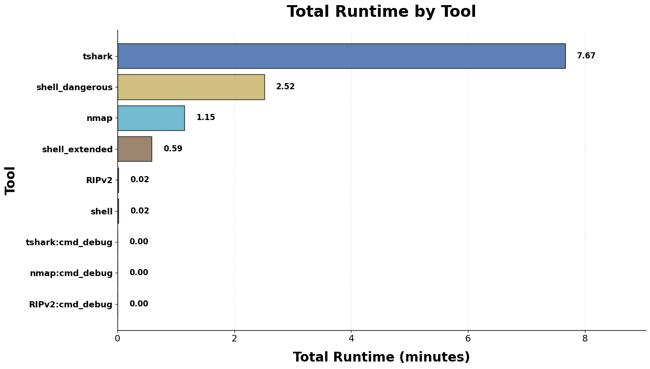
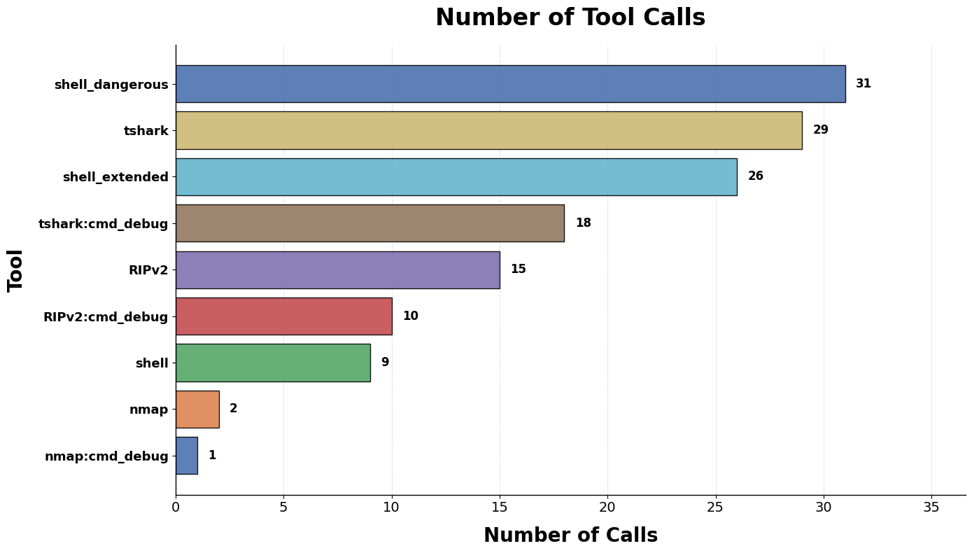
rh-agentflow_run_2026-05-02_11-04-13_native

Slide 22
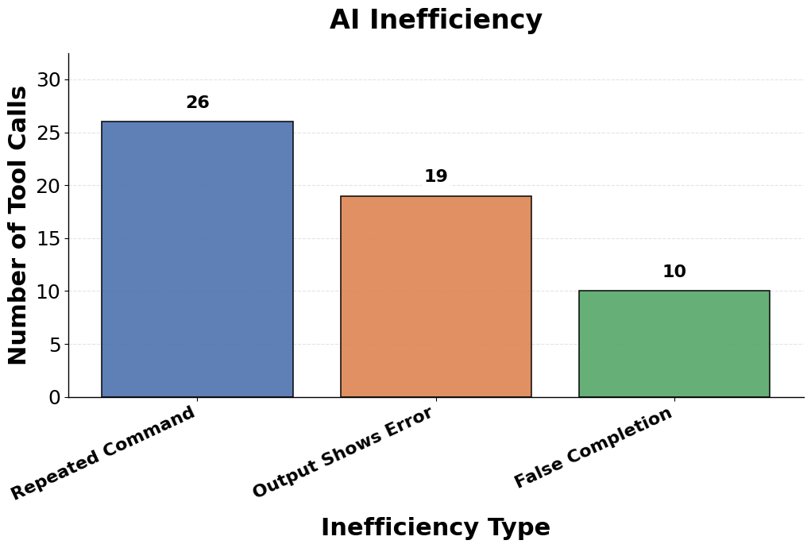
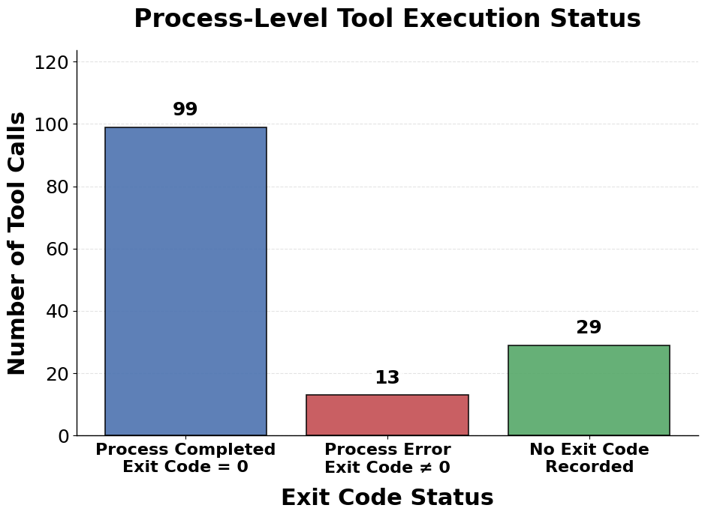
rh-agentflow_run_2026-05-02_11-04-13_native

Slide 23
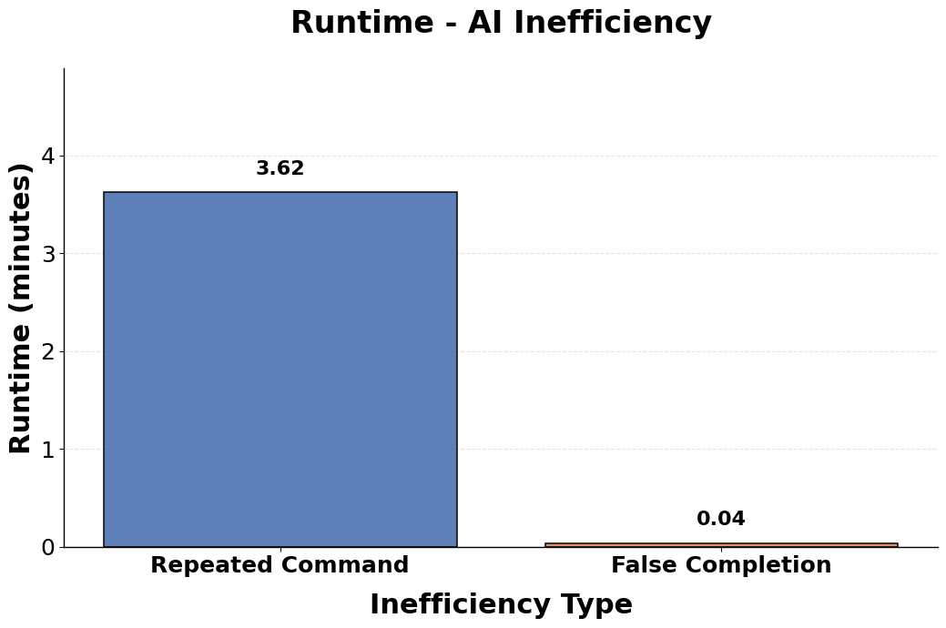
rh-agentflow_run_2026-05-02_11-04-13_native

Slide 24
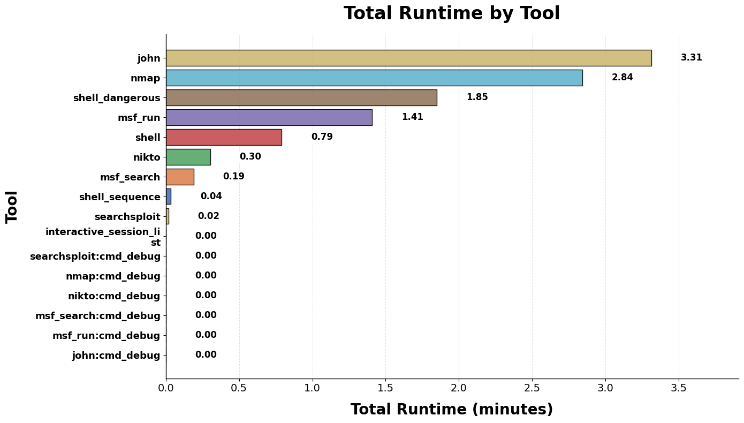
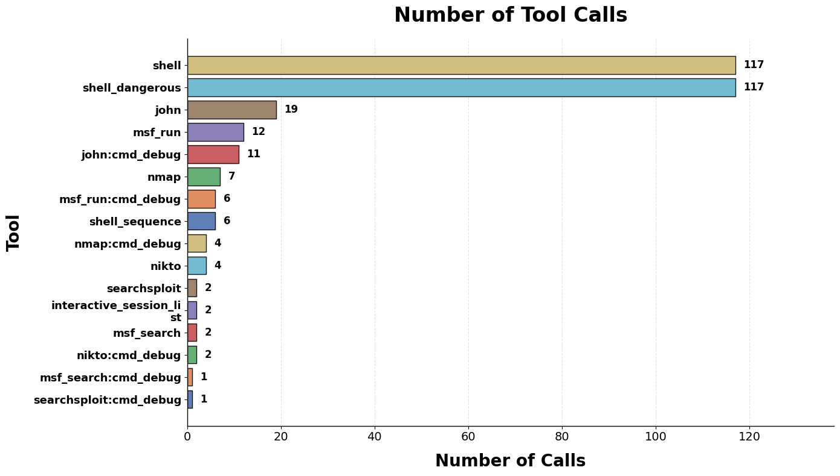
shellshock-agentflow_run_2026-05-03_23-26-45_native

Slide 25
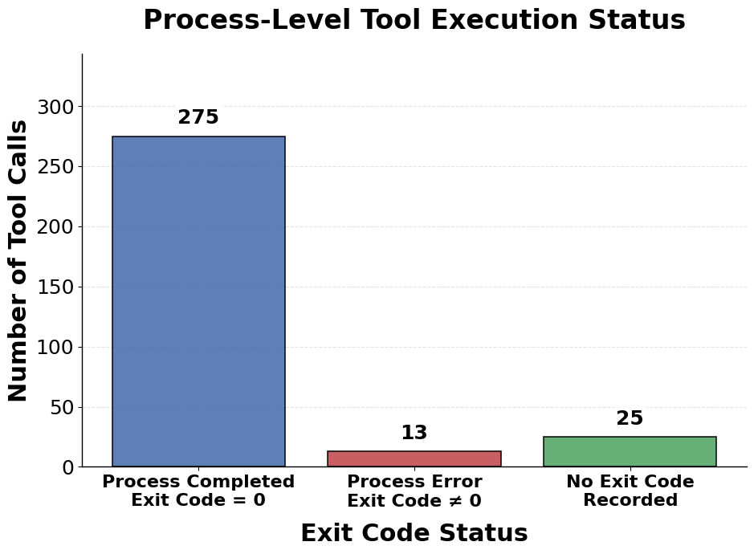
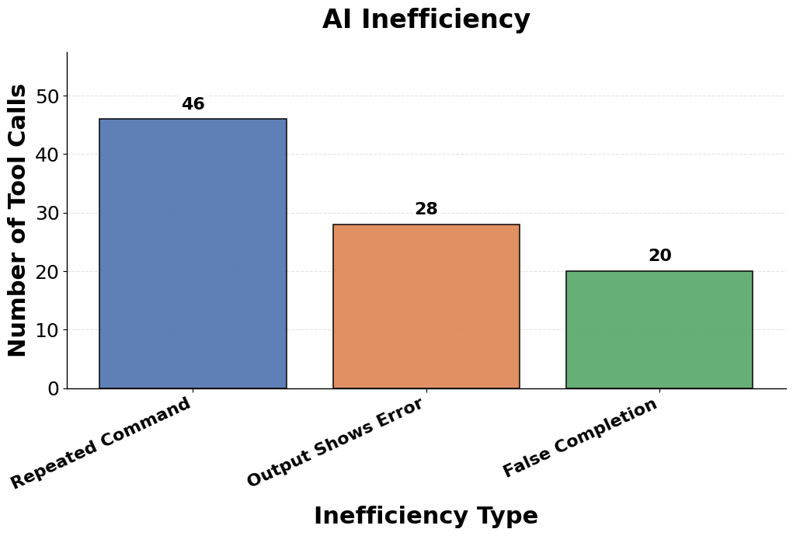
shellshock-agentflow_run_2026-05-03_23-26-45_native

Slide 26
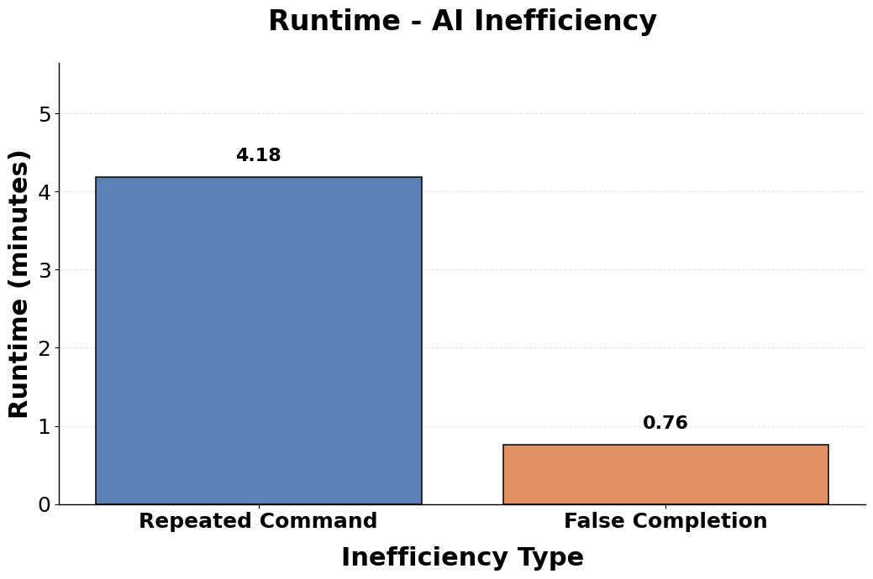
shellshock-agentflow_run_2026-05-03_23-26-45_native

Slide 27
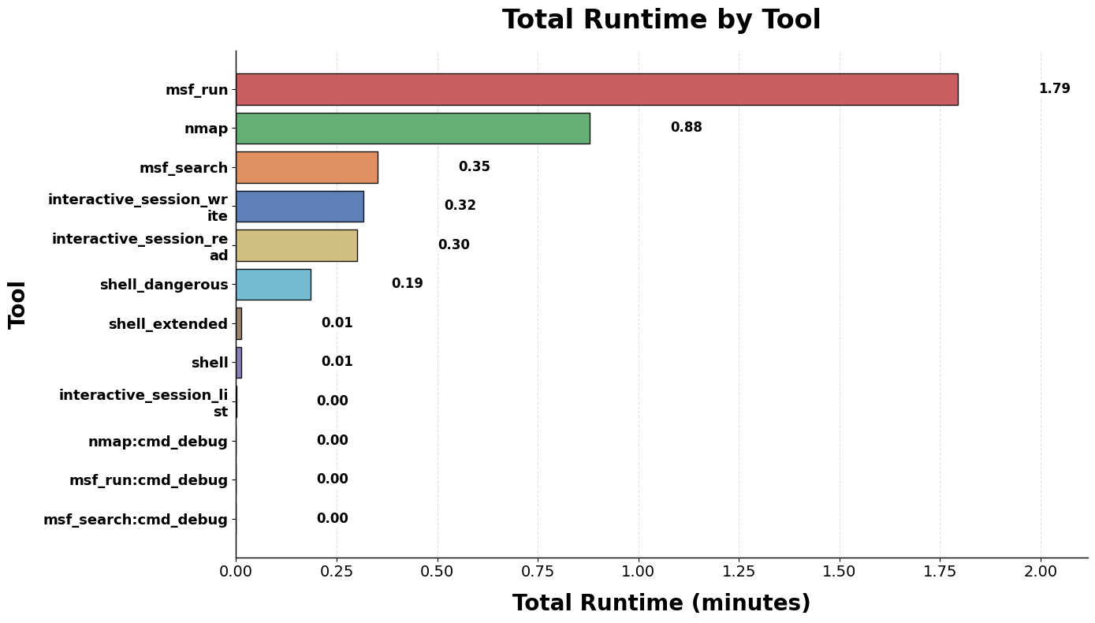
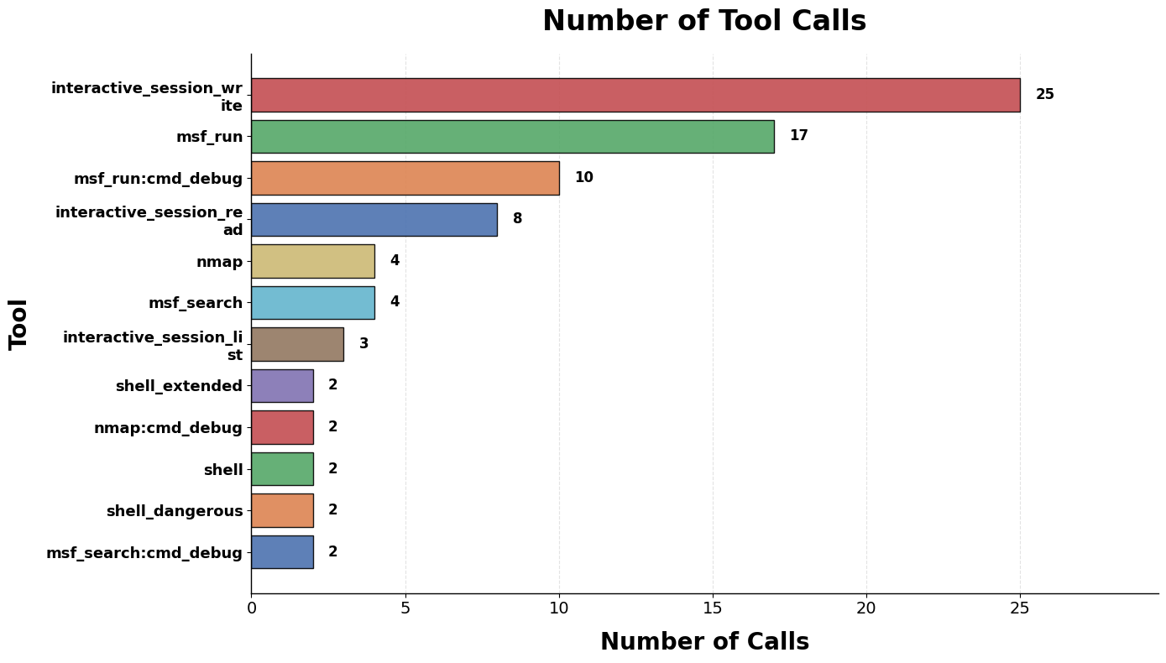
webmin-agentflow_run_2026-05-06_13-20-17_native

Slide 28
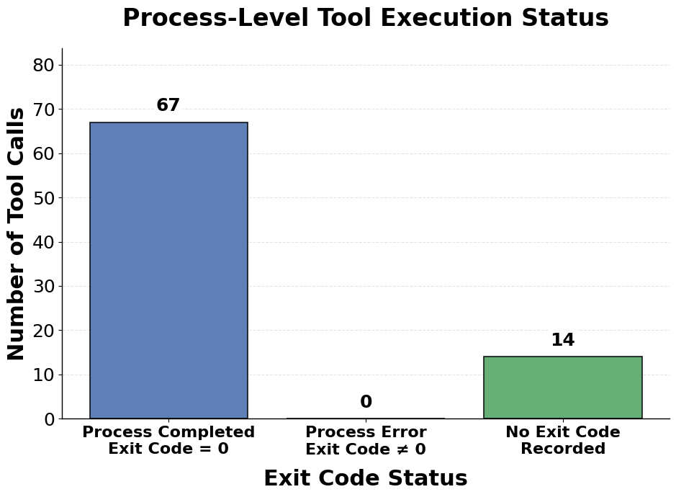
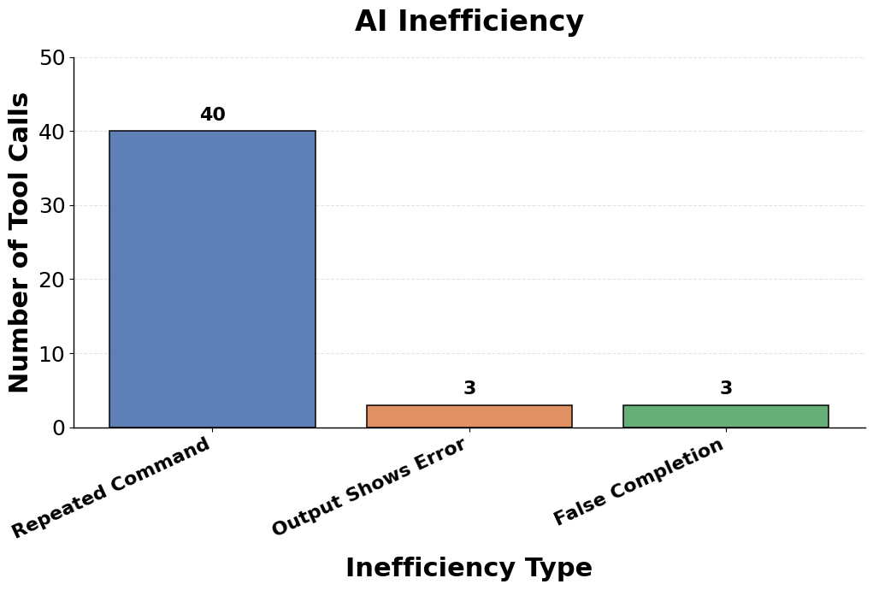
webmin-agentflow_run_2026-05-06_13-20-17_native

Slide 29
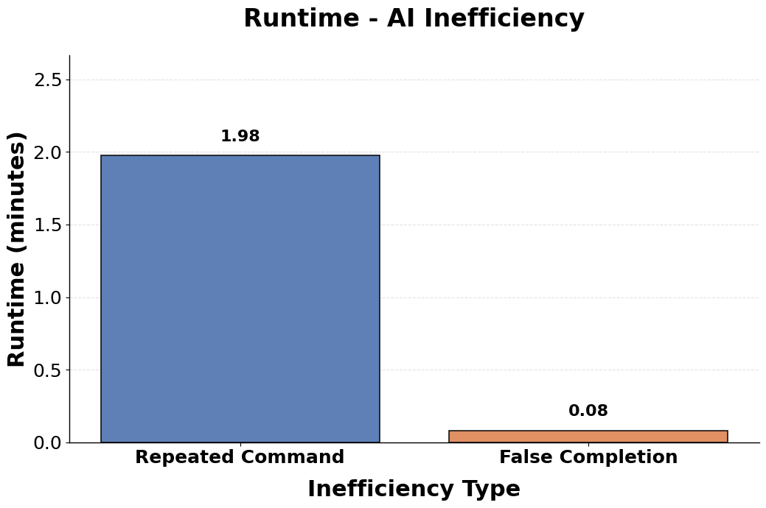
webmin-agentflow_run_2026-05-06_13-20-17_native

